Slide 1

CN101.3 - Data Communication and Network
Department of Network and Security
Network Layer
Isuru Sri Bandara
isuru.s@nsbm.ac.lk

Slide 2
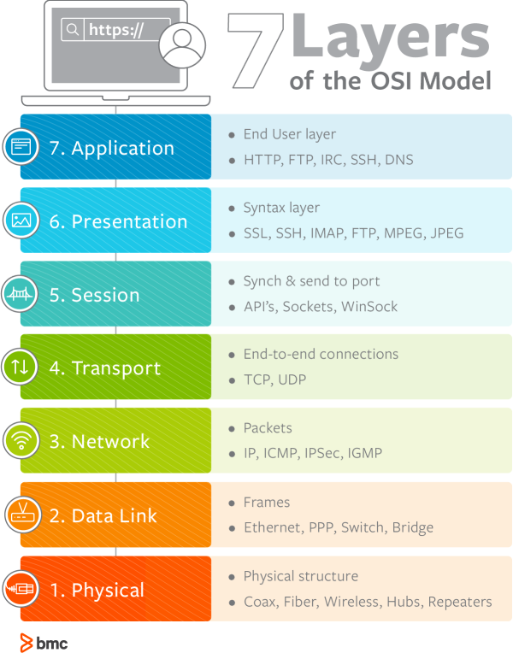
OSI Model- Network Layer

Slide 3

Network Layer Responsible for ?
Network layer is Third layer of OSI model and it’s responsible for routing packets from one node (networked device) to another between networks

Slide 4
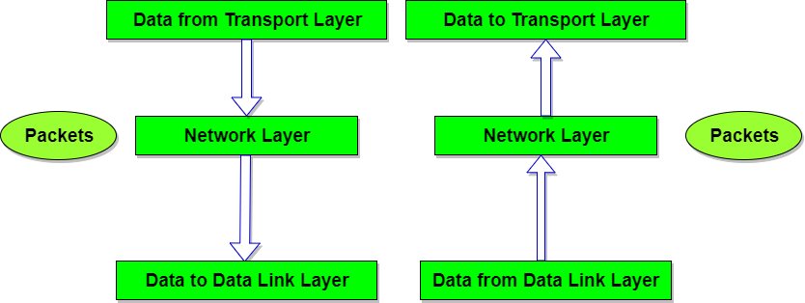

How it’s Working ?

Slide 5

Protocols that works on this layer
IP
ICMP
IPSEC
What else ?

Slide 6

Role of the layer
Logical Addressing
Routing and Forwarding
Fragmentation

Slide 7

Logical Addressing
Layer 3 uses Logical IP Addressing
IP address assigned in this layer
Ipv4 : 192.168.1.1
Ipv6 : 2001:0db8:85a3:0:0:8a2e:0370:7334
Ip address are assigned statically or Dynamically

Slide 8
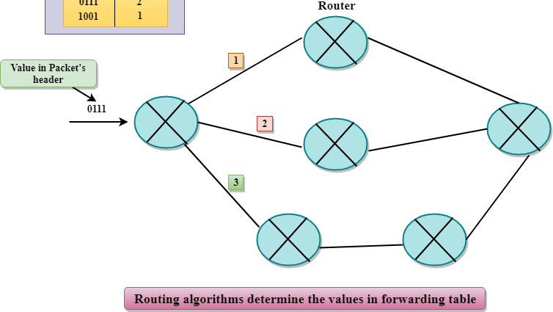
Routing
The route or path taken by packets as they flow from a sender to a receiver.
These paths are defined by routing algorithms

Slide 9

Forwarding
Forwarding action of transferring packet from an input link interface to the appropriate output link interface.

Slide 10

Fragmentation
Fragmenting is breaking up large packets into smaller chunks(Smaller data blocks)
Fragmentation is necessary for data transmission, as every network has a unique limit for the size of datagrams that it can process

Slide 11
Thank you !

